Slide 1




OOP.DSAI.2022.05
Interactive simulation of the composition of forces
Vo Dinh Dat | 20214890
Tran Quoc De | 20210179
Nguyen Minh Cuong | 20210140
Hoang Thanh Dat | 20214899

Slide 2
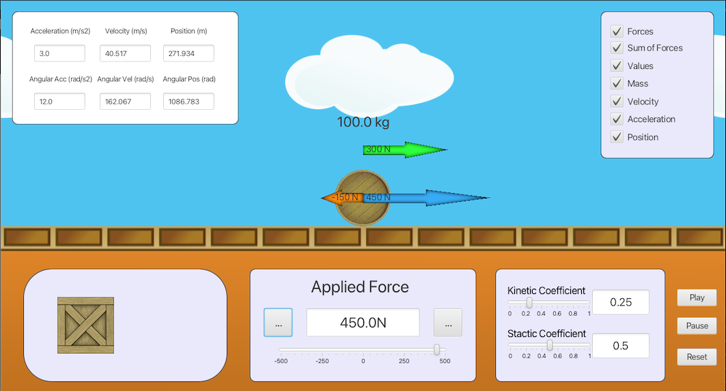
Problem Statement
BUILD A SIMPLE INTERACTIVE SIMULATION APPLICATION for demonstrating Newton’s laws of motion

Slide 3
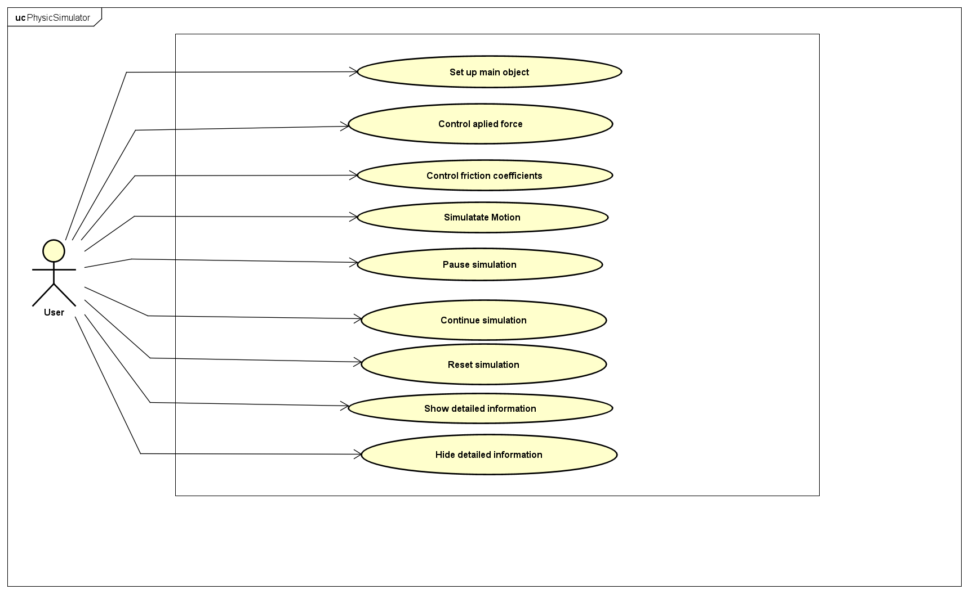
Use-case Diagram

Slide 4
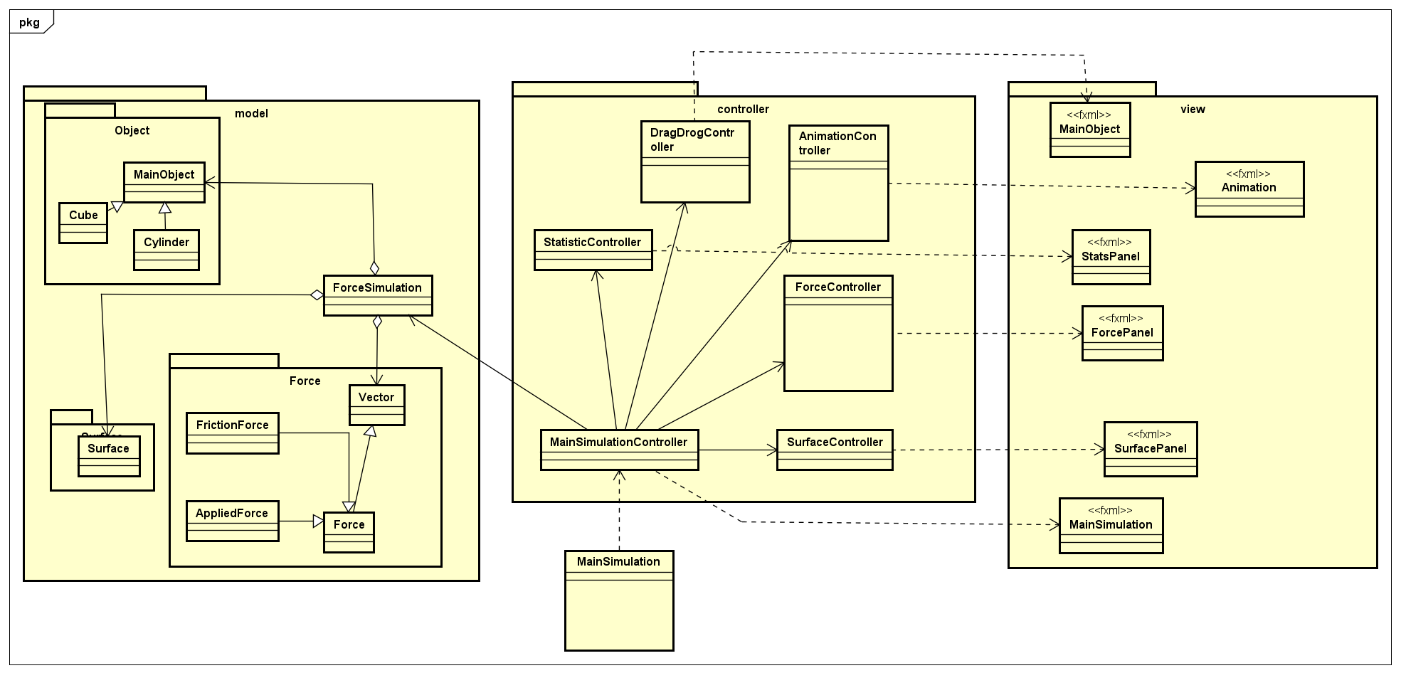
General class diagram

Slide 5
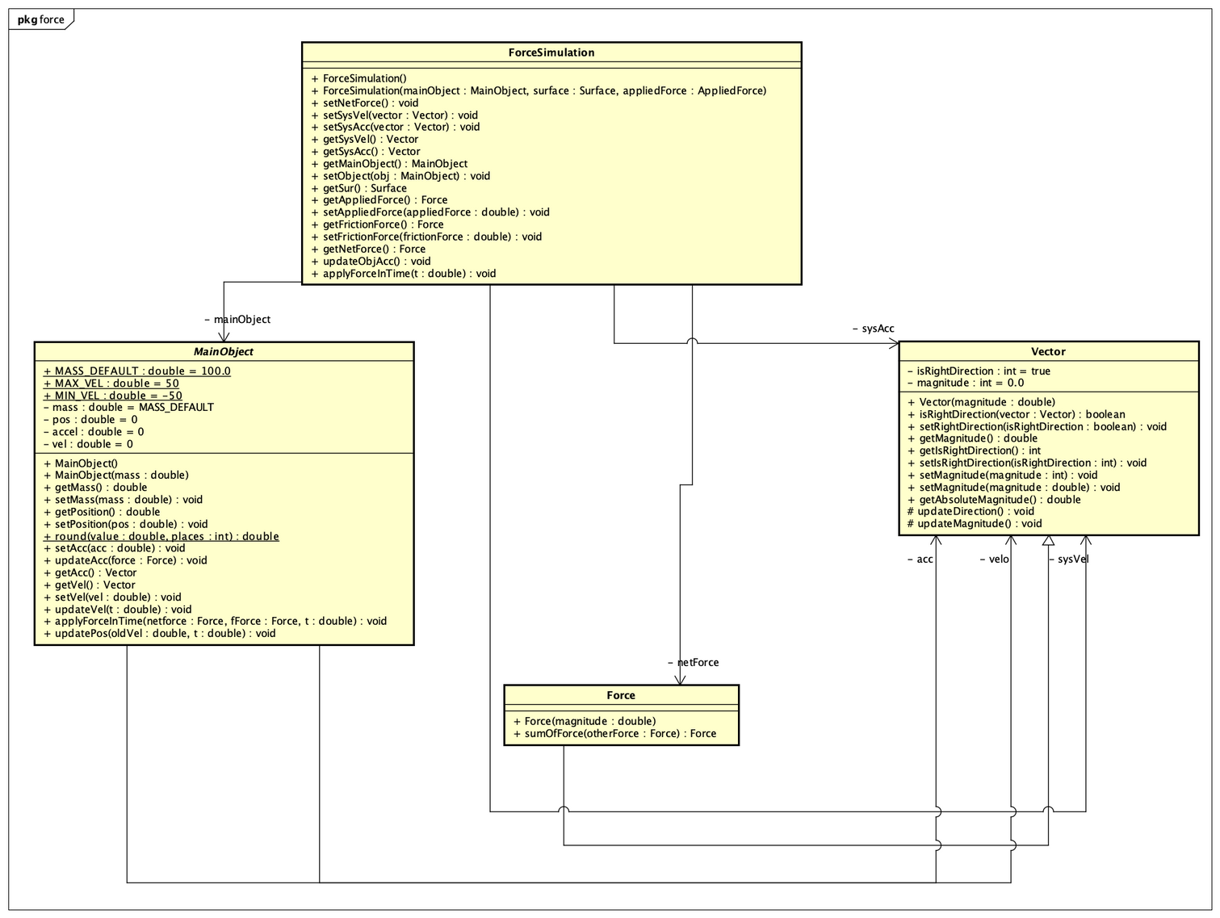


Model diagram

Slide 6

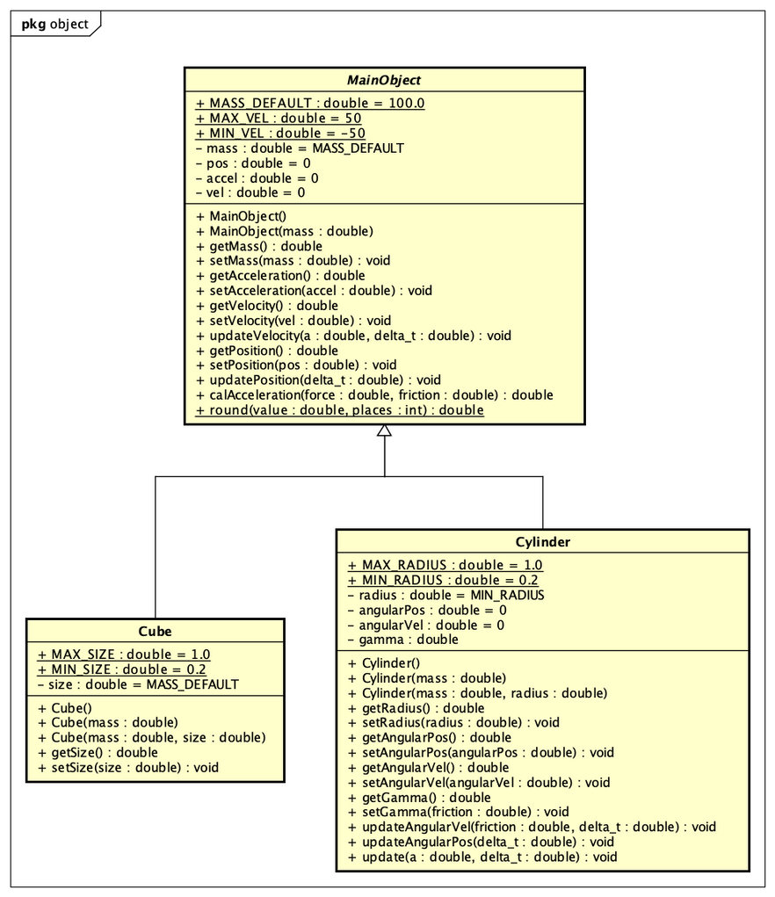
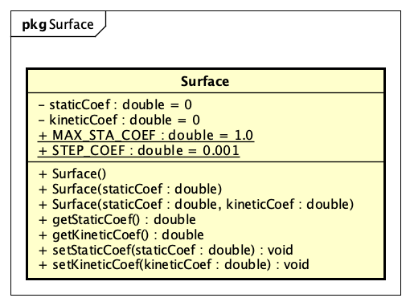
Object diagram
Surface diagram

Slide 7
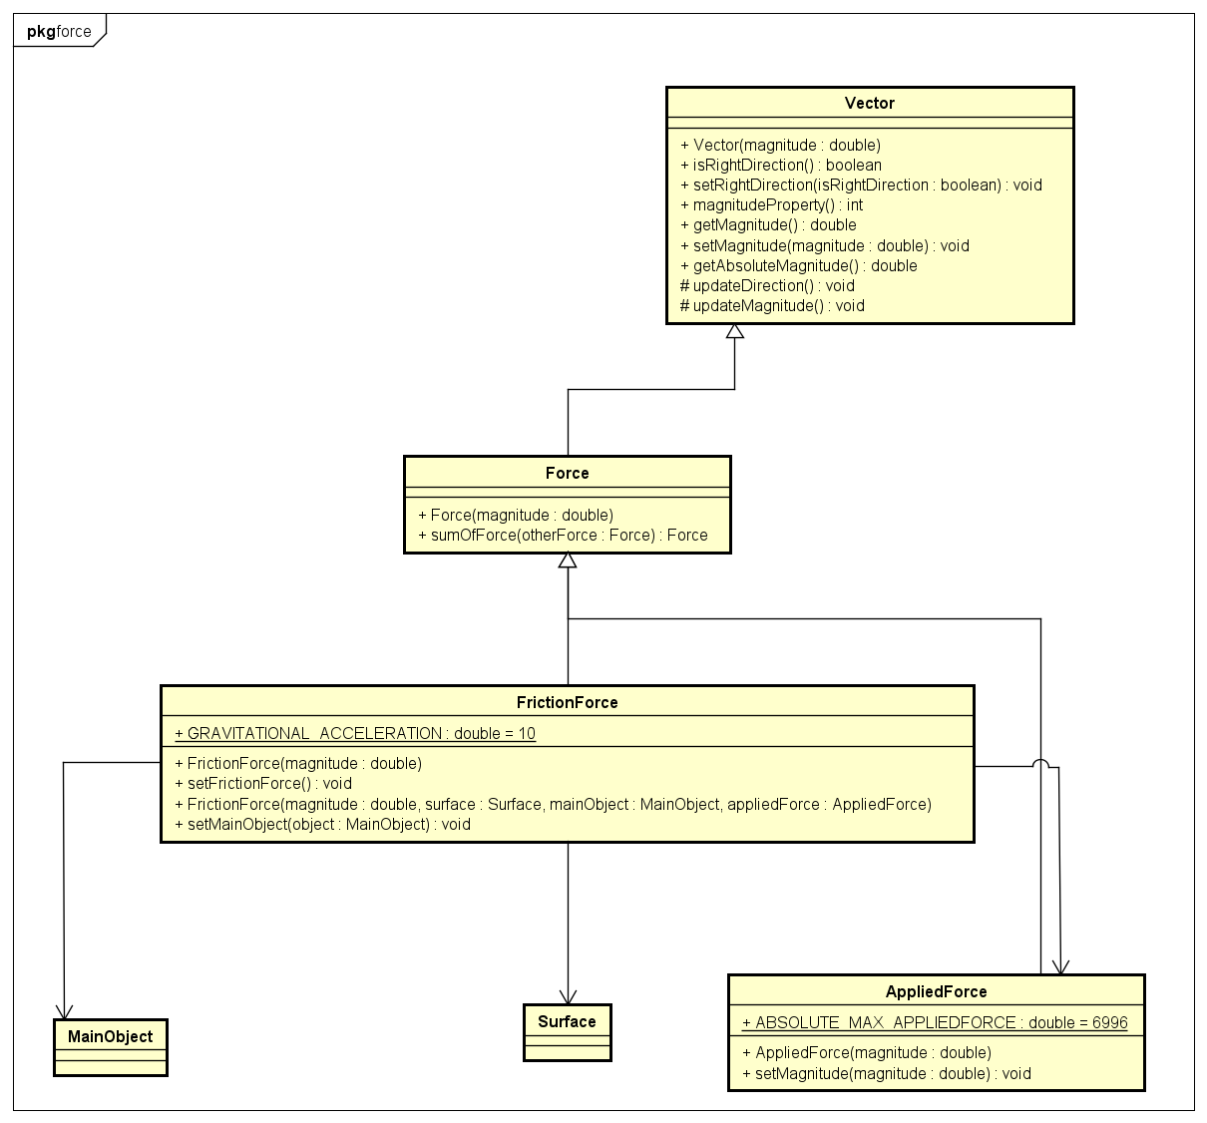

Force diagram

Slide 8
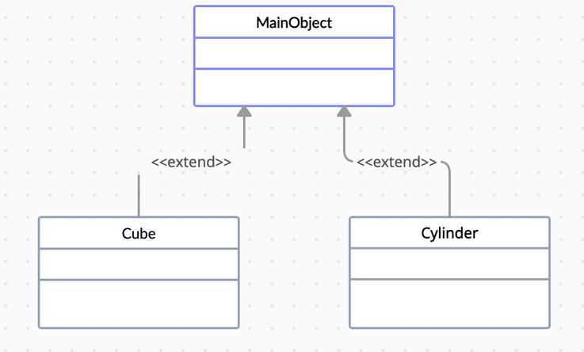
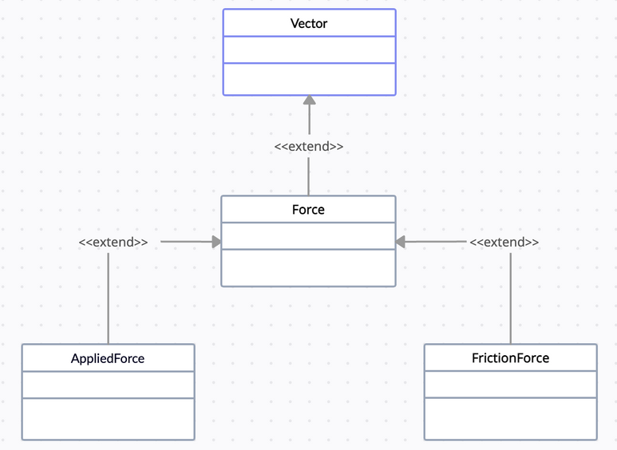
Inheritance
Cube and Cylinder
inherit from MainObject
Force inherit from Vector
Applied forces and Friction forces inherit from Force

Slide 9
Polymorphism
Object Polymorphism
Polymorphism allows enable code that operates on MainObject objects to be reused and applied to objects of Cube and Cylinder class.
Method Polymorphism
Method applyForceInTime behave differently in MainObject, Cylinder and ForceSimulation
In ForceSimulation:
public void applyForceInTime(double t) {
getMainObject().applyForceInTime(getNetForce(), getFrictionForce(), t);
}
In MainObject:
public void applyForceInTime(Force netforce, Force fForce, double t) {
updateAcceleration(netforce.getMagnitude());
updatePosition(t);
updateVelocity(t);
}
In Cylinder:
public void applyForceInTime(Force netforce, Force fForce, double t) {
updateAcceleration(netforce.getMagnitude());
updatePosition(t);
updateVelocity(t);
updateAngularPos(t);
updateAngularVel(-fForce.getMagnitude(), t);
}

Slide 10
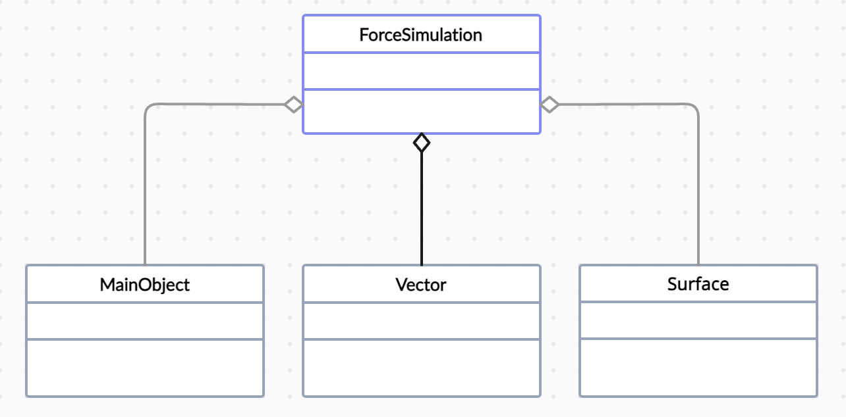
Aggregation

Slide 11
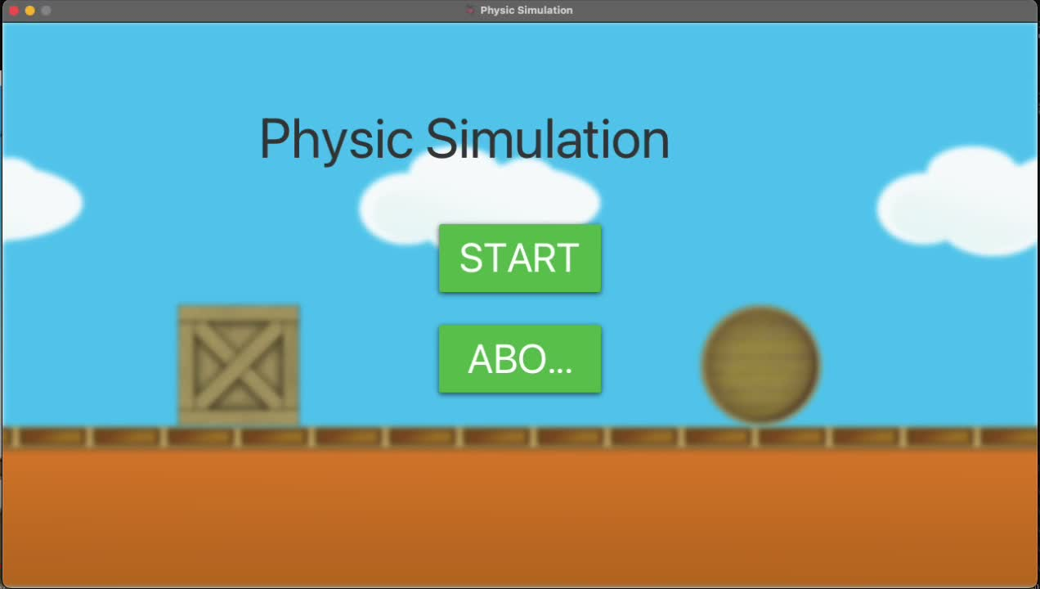
Demo
Link:https://youtu.be/w3Njpvw7YUY

